Slide 1
NAME:SANJAYA.P

Slide 2
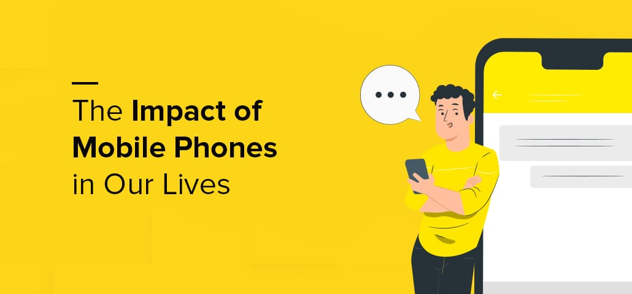

Slide 3
INTRODUCTION
→Mobile phones have become an essential part of mordern life, transform the way we communicate ,work , and live.
..**..“NOWADAYS THEY ARE LUXURY...
..... BUT NECESSITY”..**..

Slide 4
POSITIVE IMPACTS
LEARNING ACCESS:
online classes , educational apps
COMMUNICATION:
Stay connected with families ,
Friends and teachers.
ORGANIZATION:
Calendars , reminders to do some activities.

Slide 5
NEGATIVE IMPACTS
HEALTH ISSUES:
Eye strain:
staring at small screens can cause
Discomfort , dry eyes , blurred vision
DECREASED SOCIAL SKILL:
Over reliance on phones can reduce
face to face interactions.
IMPACT ON CHILDREN :
For developing children , excessive phone use can delay cognitive and language and increase risk of mental health.

Slide 6
MENTAL HEALTH ISSUES
Excessive phone usage is linked with anxiety , stress and depressions.
Social media exposure can trigger feelings of loneliness, comparisons or low self esteem.
Multitasking with phones affects problem solving and decision making.
Affects emotional stability and patience level.

Slide 7
TIPS TO PROTECT YOUR BRAIN HEALTH
Limit screen time, especially before bed.
Use blue-light filters on night mode.
Practice “phone-free” times (meals, study,sleep).
Engage in offline activities (reading, exercise,hobbies).

